Slide 1
East European households’ resource-use practices: Learning from the epistemic periphery? Transformations Community European Hub Conference Prague, 12 – 14 July 2023
Petr Jehlička
petr.jehlicka@soc.cas.cz

Slide 2
OUTLINE
To highlight a couple of inspiring but little known facts about household use of resources in Czechia and wider Eastern Europe
water
food waste
food self-provisioning and diverse and resilient food system
2 But sustainable household practices in Eastern Europe not really used as a source of inspiration and “international knowledge” – why?
3 What can be done about it?

Slide 3
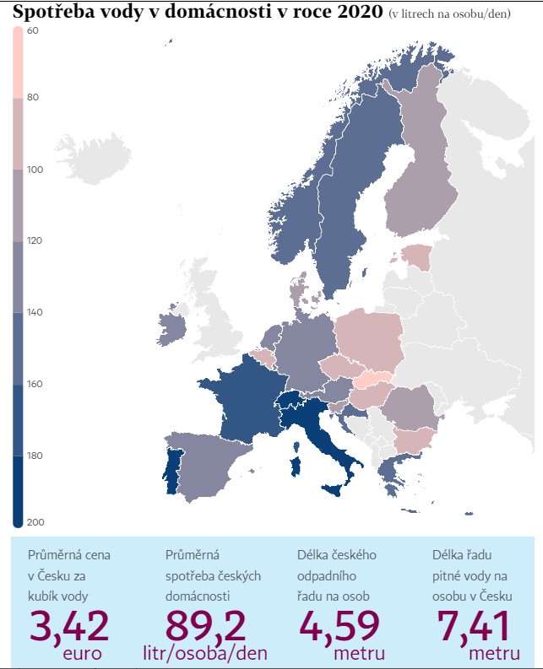
Czechia – 4th lowest household consumption of metered water in Europe (after Slovakia, Malta and Estonia):
89.2 litres per person per day (2020)
Highest consumption: Switzerland (300 litres per person per day
And then: Italy, Portugal and France
Source: Hospodářské noviny, 17 Feb 2022

Slide 4
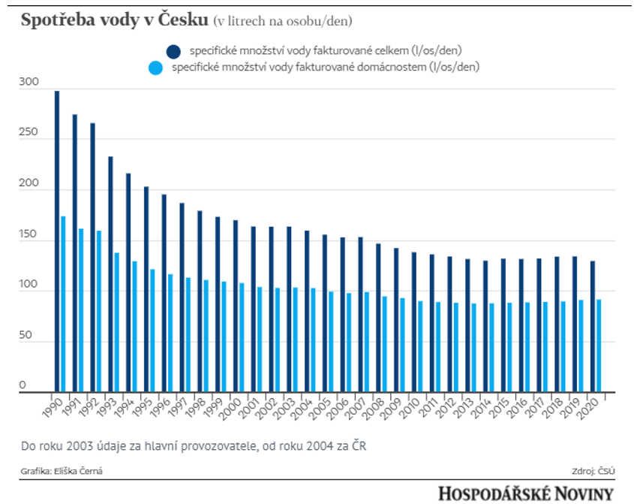
WATER
Czechia: continuous decrease in consumption:
1990: 173.0 litres per person per day
2020: 89.2 litres per person per day (nearly half)
(household water consumption depicted by light blue colour)
Source: Hospodářské noviny, 17 Feb 2022

Slide 5
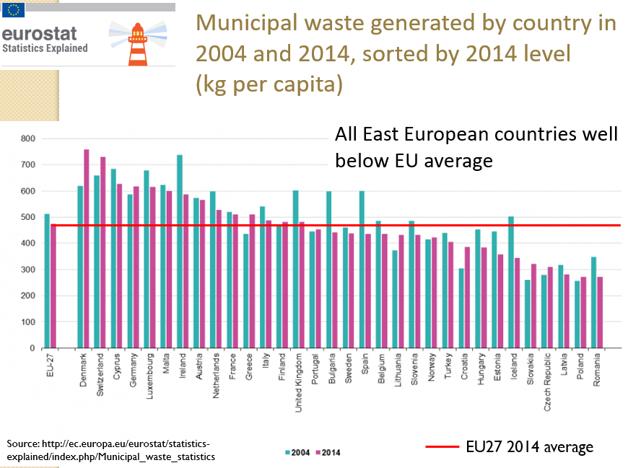
WASTE
Low levels of municipal waste in East European countries:
All of them below EU average

Slide 6
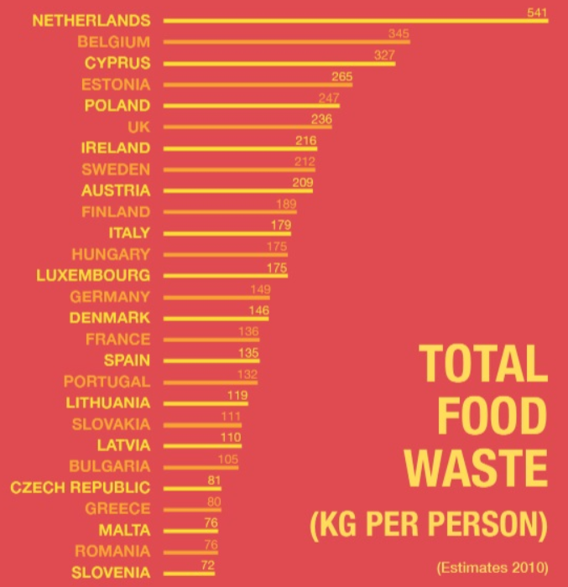
Total amounts of food waste in the EU (2010):
EU average of total food waste: 173 kg per person per year (the whole food chain)
East European countries below the average except for Poland, Estonia and Hungary
But: these are estimates and figures concerning food waste are notoriously unreliable

Slide 7
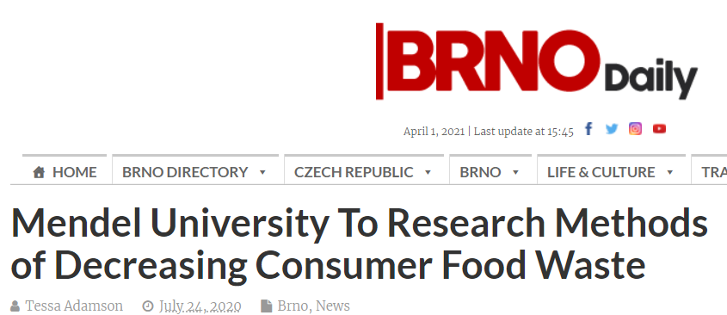
Puzzle: this + other recent projects on household food waste conducted by Czech scholars all justified by the need to find ways of reducing waste.
To me, the real mystery of this research topic is:
Where is the missing waste?
How come Czech households produce so little food waste?
-> crucial questions, given the gravity of the food waste problem
But nobody knows the answer…..

Slide 8
Household food waste per person
EU average: 92 kg per year
Brno households 37 kg per year
(N=900)
40% of EU average
Mendel University team’s findings:
-> if the current EU-wide average of household food waste 91.7 kg per person per year were considered the baseline amount for Czechia in 2021….
…..the country would have already met and exceeded – a decade earlier - the European Commission’s commitment to halving the amount of food waste in the EU by 2030

Slide 9
Rather than raising ‘consumer awareness of the meaning of “use-by” and ”best-before” dates’ and incentivising shops to donate unsold food to charities (the EU’s approach)……
……..the key to understanding low to negligible amounts of food waste produced by Czech households - in the sphere of everyday practices and routinised behaviours - and related skills and knowledge
To start unravelling the “mystery of the missing food waste”:
six focus groups held in Brno in the autumn 2021
participants from three types of residential areas in Brno
two groups in each area:
blocks of flats
private villas
rural houses with gardens on Brno outskirts

Slide 10
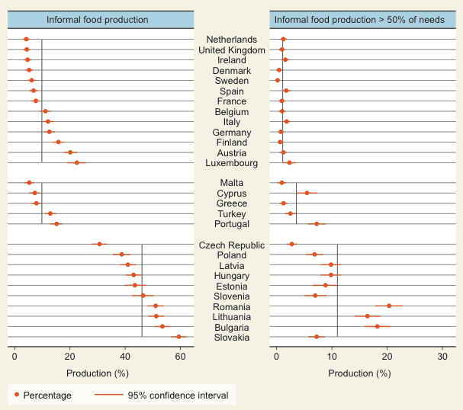
FOOD
The extent of food-self provisioning in Europe (2003): millions of East Europeans growing their food
Source: Alber & Kohler (2008)

Slide 11
Headline figures on Central and East European food self-provisioning
Widespread – Croatia 50%, Czechia 40%, Poland 54% of population grow food
Socially diverse – people from all educational and occupational backgrounds grow food (58% Poles with primary and 55% with tertiary education grow food)
Evenly distributed across class and economic status (but: more middle than working class activity: PL 55% middle; 51% working; CZ middle 43% and working 37%)
Generous activity – many growers share their produce with others (Czechia 60% and Poland 40%) – with family, friends, neighbours…
Nearly ½ of Polish and Czech food growers produce non-certified organic food

Slide 12
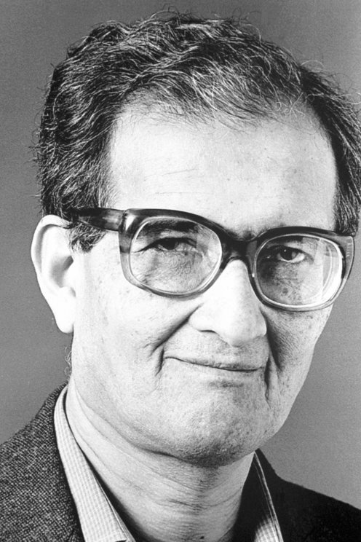
ENDOWMENT SET
Social resilience = adaptability to a disturbance
central to food security studies
Link to Amartya Sen’s concepts:
endowment set = a combination of all resources legally owned by a person
tangible: land, equipment, animals
intangible: knowledge and skills, membership in a community, labour resources

Slide 13
ENTITLEMENT SET
entitlement set = all combinations of goods and services a person can obtain by using the resources of the endowment set
The resources in an endowment set can be used to obtain food in three ways:
exchange (use of labour to purchase food)
transfer (use of membership in a local community to obtain food as a gift)
production (use of land and skills to produce food)
the greater the diversity of entitlements the greater likelihood of avoiding vulnerability and of food security => resilience

Slide 14
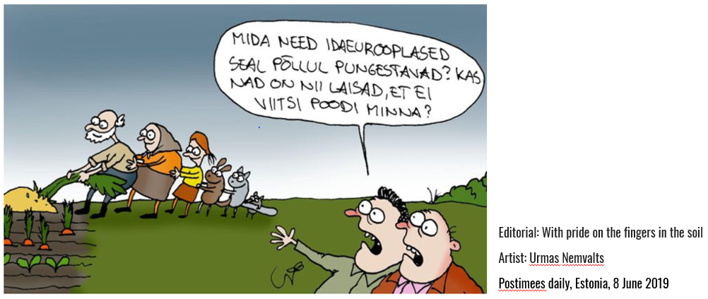
But sustainable household practices in Eastern Europe not really used as a source of inspiration and “international knowledge” – why?
What are those East Europeans playing at over there? Are they so lazy that they can’t even go to the (food) shop??

Slide 15
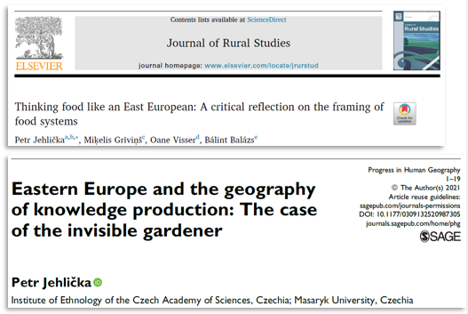

Slide 16
4 FACTORS
1. Eastern Europe – perennial learner and recipient of know-how from the West:
Popular strand of research: how East European societies receive and ‘learn’ sustainability initiatives imported from the West as recipients of Western sustainability agendas (Mincyte 2012)
Two effects of this approach:
a) obscures the diversity of food practices in Eastern Europe
b) prioritises a marginal set of practices over the more prevalent ones
2. Developmentalist perspective: post-1989 transformation of Eastern Europe seen as a unidirectional process from a non-market to a market, from an informal to a formal economy, i.e. from tradition → modernity
Eastern Europe simultaneously viewed as:
a) on the slow linear development path
b) as stuck in time (retrospective markers ‘ex-Soviet’ and ‘ old Eastern Bloc’ - Müller 2018)

Slide 17
4 FACTORS
3. The economization of social science research on Eastern Europe
The focus on poverty, shortage, and scarcity – Factor 3 that prevented East European household practices from being reframed as inspiring, innovative, and transferrable to other contexts
4. Eastern Europe: social context outside the theory generating axis
‘unlike in the South, people have not found in the East […] a source of alternatives to neoliberalism [and] environmental destruction’ (Müller 2018) → in contrast to the South, the European East has not become a valued source of a multiplicity of knowledge
Eastern Europe’s location outside the axis that connects the former metropoles with former colonies in the circuits of internationally recognized knowledge (theory]

Slide 18
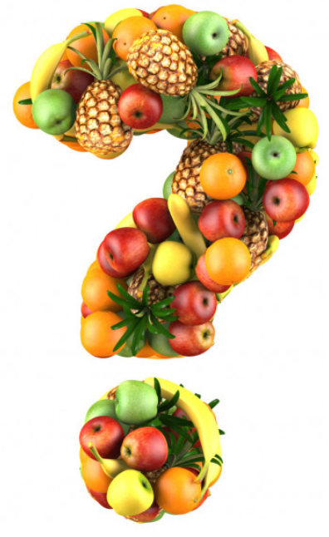
Why does all this matter?
Why is it important to understand this ‘missed opportunity’ / ‘lessons from Eastern Europe that have not been learned’?
1. The gravity of the global environmental crisis requires searching for responses in all social contexts, not just in the West / center where the conventional notion of sustainability was coined
2. Need to make the flow of scholarly communication multidirectional as opposed to the unidirectional West → the Rest (East, South….) flow -
Wikimedia Commons

Slide 19
Learning from the periphery?
Need to extend and diversify the notion of a sustainable food system to include informal, already existing sustainable practices The threat of a loss of informal, already existing sustainability because of the import of the conventional model of sustainability (benefits of imported models may not compensate for the losses) This way of thinking invites us: - to think beyond the intentionality of sustainable behaviour to include ‘sustainability by outcome rather than intention’ (‘quiet sustainability’) - to move beyond sustainability based on constraints and limitations - to include sustainable behaviours associated with joy. pleasure and exuberance - to value what already exists and its maintenance X sustainability as a novelty, creativity, innovation, digital technology…

Slide 20
petr.jehlicka@soc.cas.cz Transformations Community European Hub Conference Prague, 12 – 14 July 2023

